Slide 1
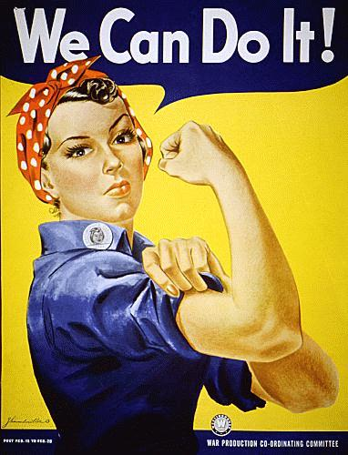
Functional Art?
Yes we can!

Slide 2
What is Functional Art?
Functional art is the application of design and decoration to everyday objects to make them aesthetically pleasing. The term is applied in distinction to the fine arts which aims to produce objects which are beautiful and/or provide intellectual stimulation. In practice, the two often overlap.
The fields of industrial design, graphic design, fashion design, interior design, architecture and the decorative arts are considered functional art/applied arts.

Slide 3
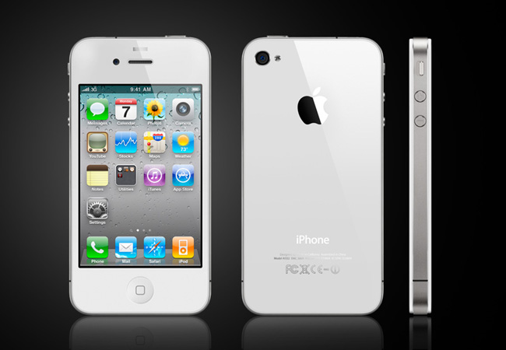
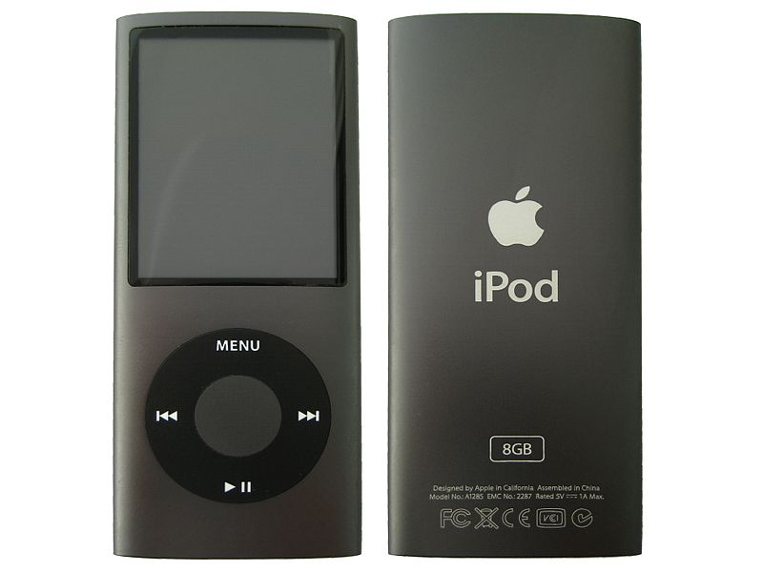
Industrial Design
Industrial Design is the use of both applied art and applied science to improve the aesthetics, ergonomics, functionality, and/or usability of a product, and it may also be used to improve the product's marketability and even production. The role of an industrial designer is to create and execute design solutions for problems of form, usability, physical ergonomics, marketing, brand development, and sales.
Industrial design can overlap significantly with engineering design, and in different countries the boundaries of the two concepts can vary, but in general engineering focuses principally on functionality or utility of products whereas industrial design focuses principally on aesthetic and user-interface aspects of products

Slide 4
Fashion Design
Fashion design is the art of the application of design and aesthetics to clothing and accessories. Fashion design is influenced by cultural and social latitudes, and has varied over time and place. Fashion designers work in a number of ways in designing clothing and accessories; and, because of the time required to bring a garment onto the market, must at times anticipate changing consumer tastes.
Fashion designers attempt to design clothes which are functional as well as aesthetically pleasing. They must consider who is likely to wear a garment and the situations in which it will be worn.

Slide 5
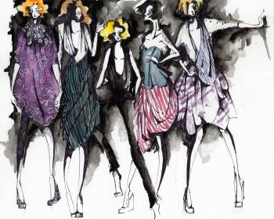
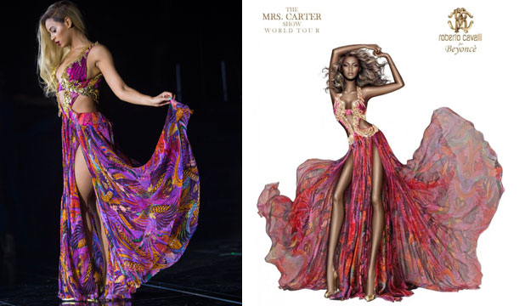
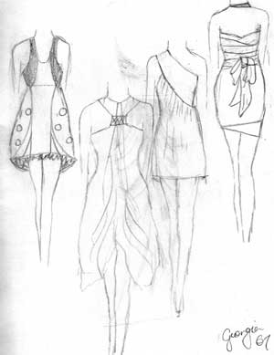
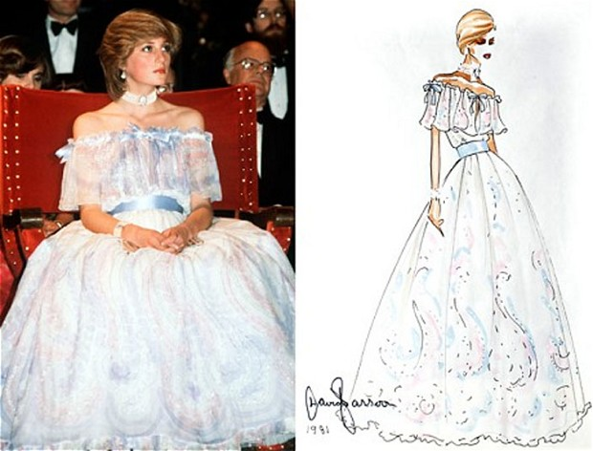
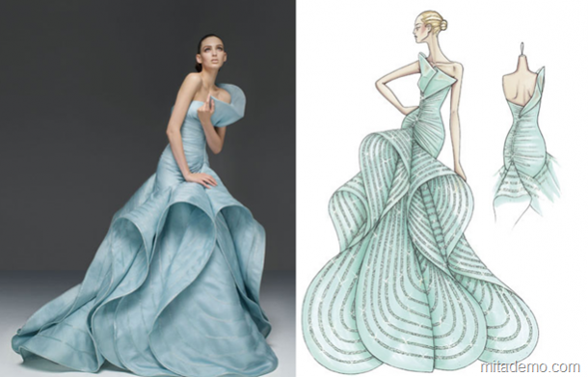
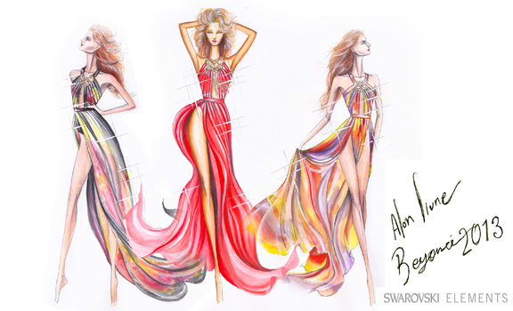
Fashion Design
1- Have a buyer in mind
2- Sketch out the clothes and/or accessories
3- Create the clothes and/or accessories out of fabric or other materials.

Slide 6
Graphic Design
Graphic design is the art of communication, stylizing, and problem-solving through the use of type, space, and image. Graphic designers use various methods to create and combine words, symbols, and images to create a visual representation of ideas and messages. A graphic designer may use a combination of typography, visual arts and page layout techniques to produce a final result. Graphic design often refers to both the process (designing) by which the communication is created and the products (designs) which are generated.
Common uses of graphic design include identity (logos and branding), publications (magazines, newspapers and books), print advertisements, posters, billboards, website graphics and elements, signs and product packaging. For example, a product package might include a logo or other artwork, organized text and pure design elements such as images, shapes and color which unify the piece. Composition is one of the most important features of graphic design, especially when using pre-existing materials or diverse elements.
What are some things you use that have been designed by a graphic designer?

Slide 7
Graphic Designers have to consider what type of font they will use to get across the feeling they want. SHOULD THINGS BE IN ALL CAPS? Should it have an old feel to it? How does this font come across?
A font is a lot like handwriting, you wouldn’t scribble out an essay to a prestigious college you hope to attend, but you might to an informal BFF. ☺ <3
Consider the fonts on the next ads, also, keep in mind views on culture, and who the target audience is.

Slide 8
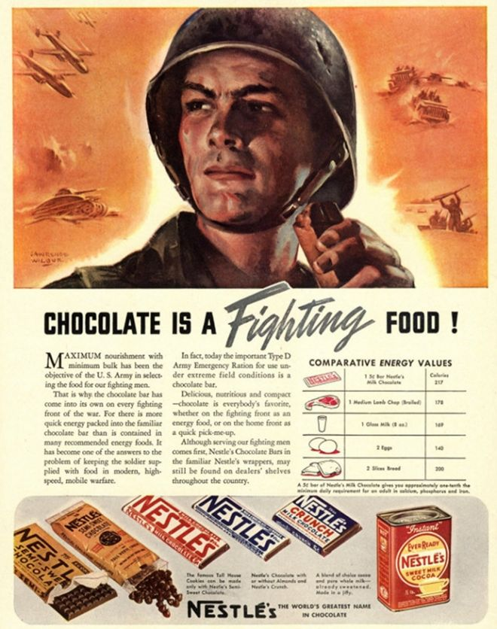
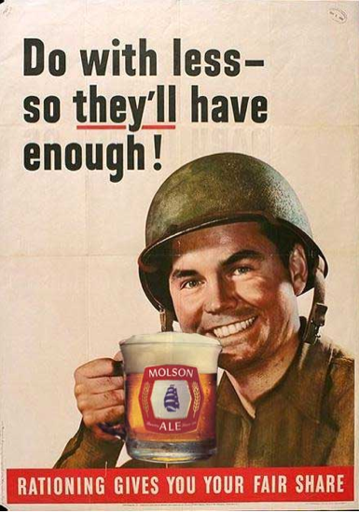
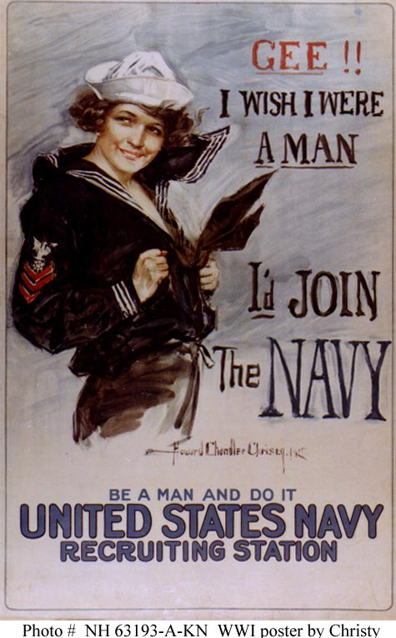
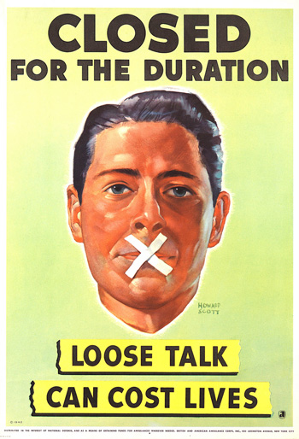
Graphic Designs for WWI & WWII a.k.a BEFORE COMPUTERS

Slide 9
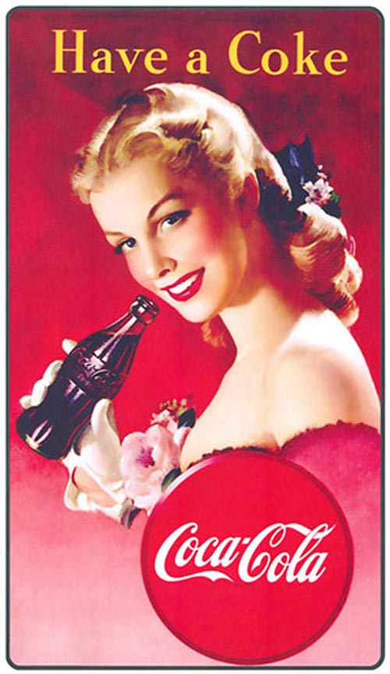
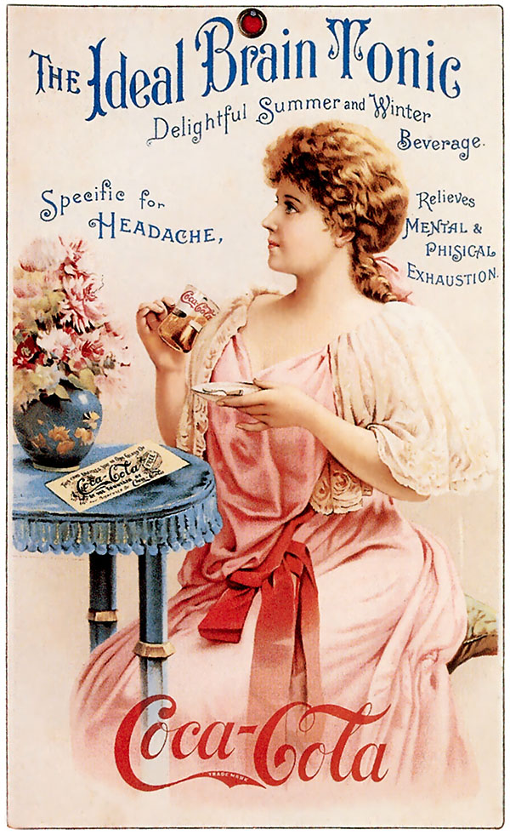
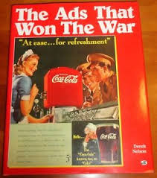
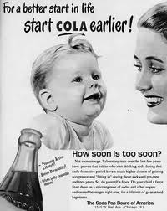
Product Ads from Coca Cola
Who is the target audience in these product ads? Male or Female? What views on culture do they have? How are these fonts used different or the same as the fonts for WWI and WWII?

Slide 10
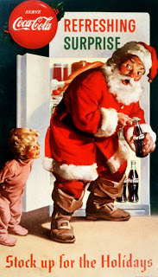
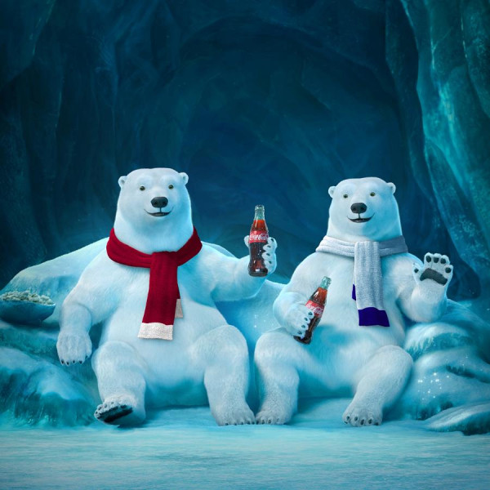
Has the target audience of this ad changed compared to current day?
1930’s vs. Current Day

Slide 11
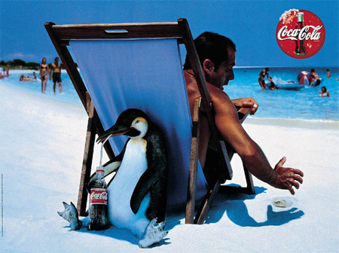
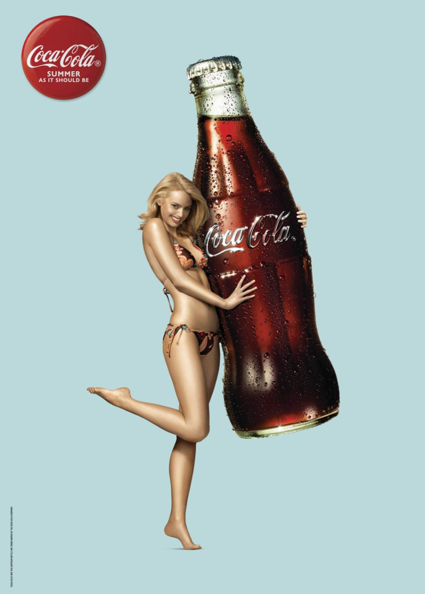
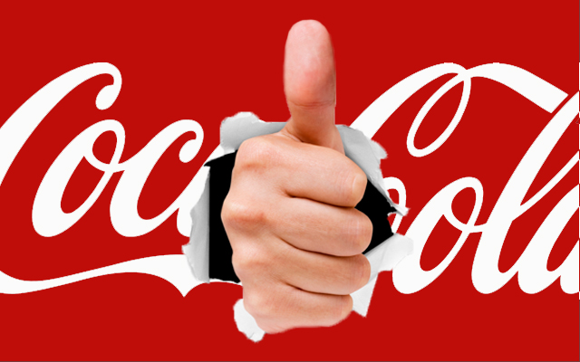
Who drinks Coke today?
Who is coke’s target audience and why?
Men or Women?

Slide 12
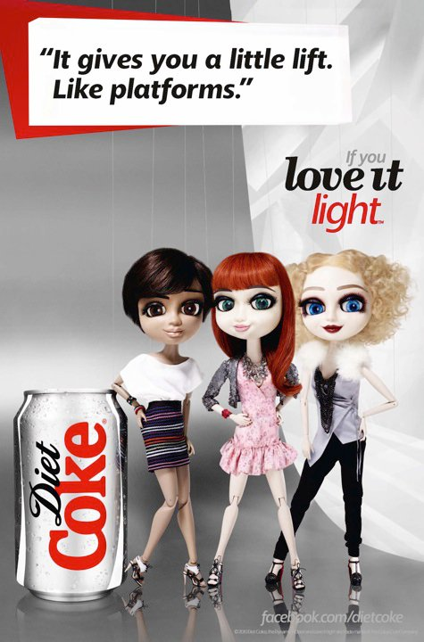
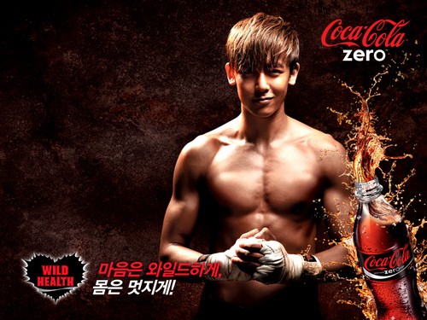
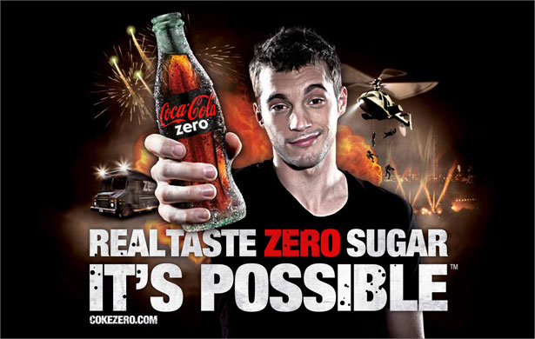
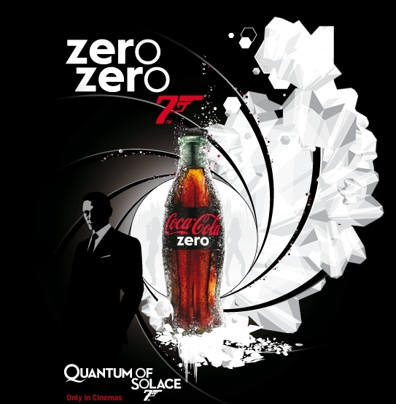
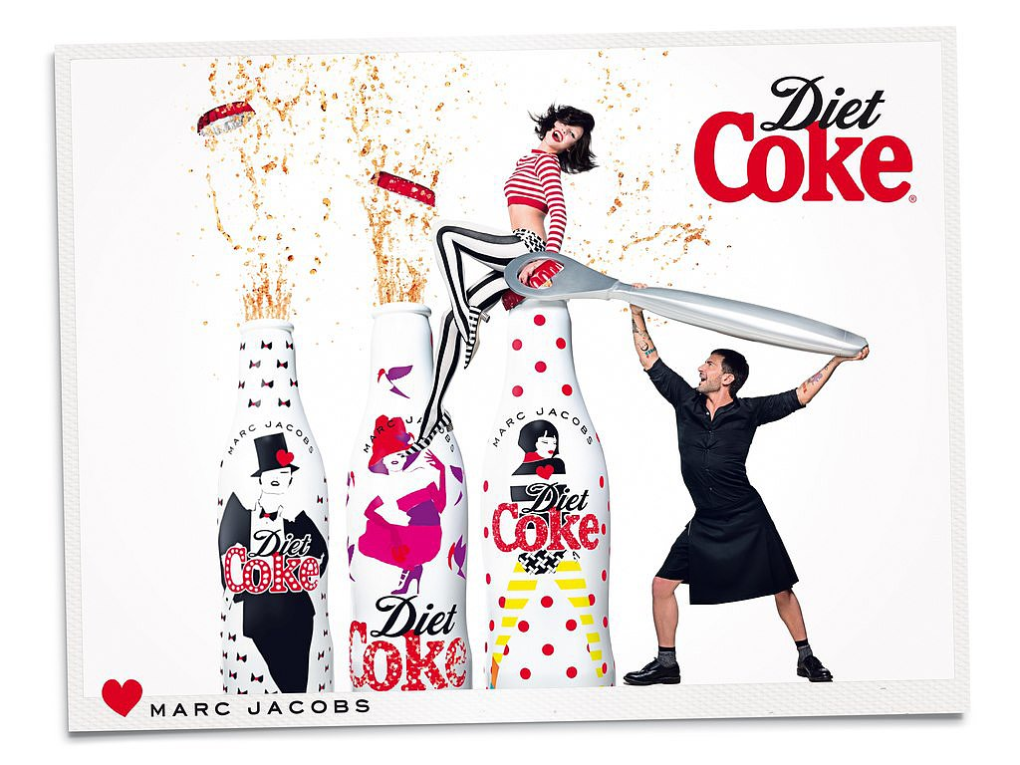
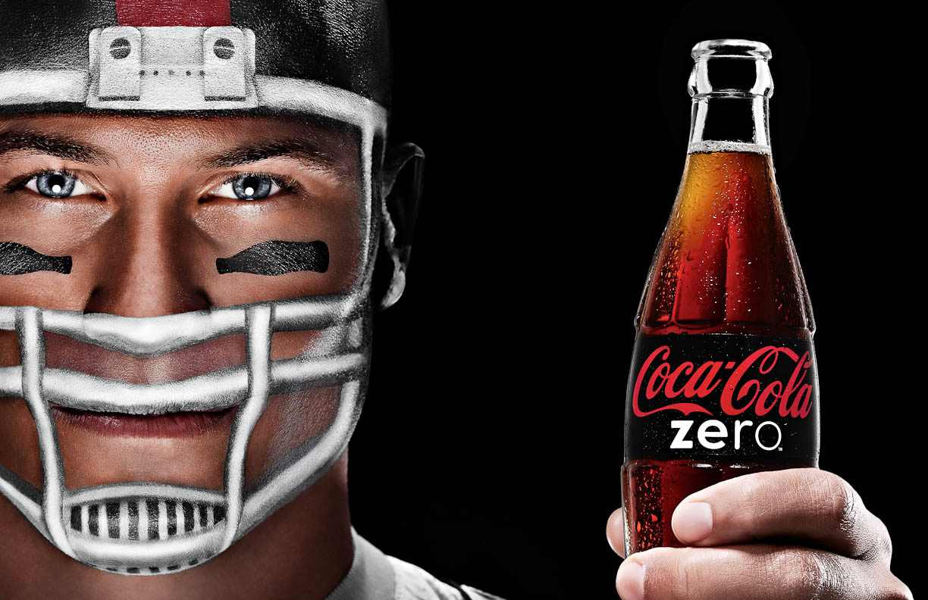
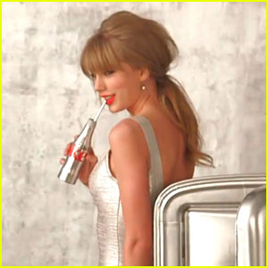
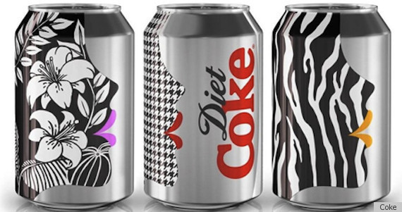
Who drinks Diet Coke?
Even Fashion Designers advertise Diet Coke??
What age are they appealing to?
What if men want something with no calories but want to still look “manly”?

Slide 13
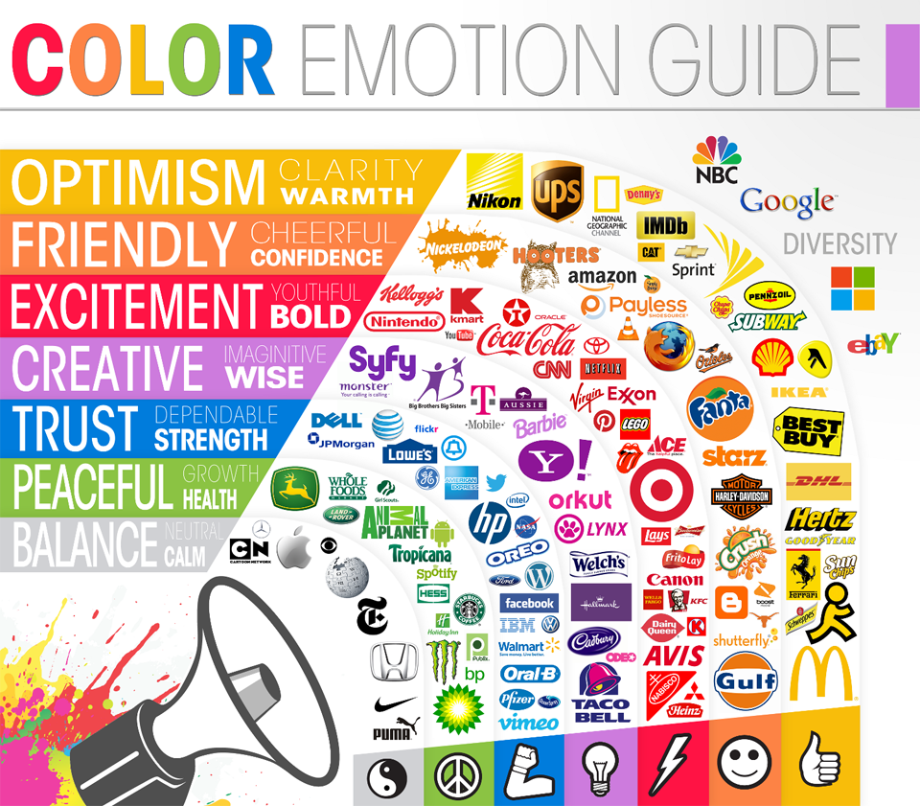

Slide 17
Your Task:
Create a product and an advertisement for your product.
Your advertisement will need:
Target Audience Demographics- Who does it appeal to? What ages? Male or Female? Income level?
A Logo
A Color Scheme and reason for color choices.
A description of your product (brief in the ad itself, 1 paragraph turned in. Example: ad: A beautiful dress for beautiful women! Turn in: I created this dress so that people could go to famous parties in it… etc.)

