Slide 1
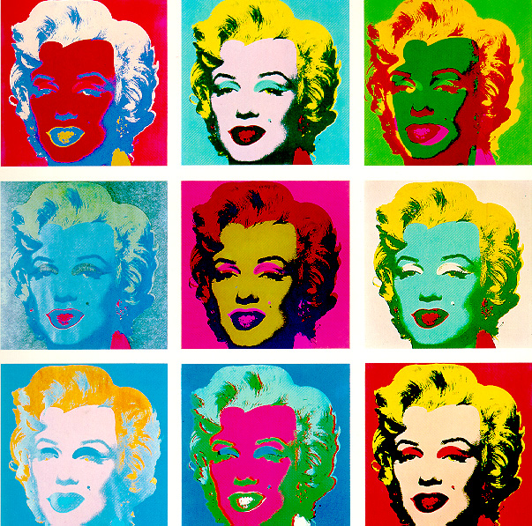
Drill: 9/26/2013 After reading the definition, explain why this image would classified under Formalism. Formalism: A theory of art which places emphasis on design qualities. According to this theory, the most important thing about the work is the effective organization of the elements of art and use of the principles of design.

Slide 2
Art Elements
Principles of Design
Line
Shape
Form
Texture
Color
Value
Space
Balance
Emphasis
Harmony
Variety
Movement/Rhythm
Proportion
Repetition

Slide 3
Aesthetic Theories of Art
Imitationalism
Formalism
Emotionalism
Functionalism

Slide 4
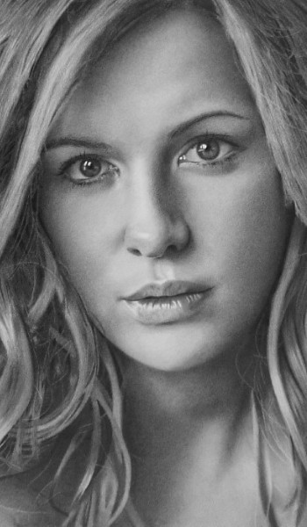
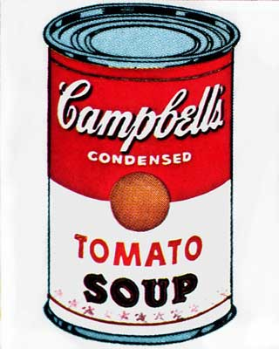
Aesthetic Theories of Art
Imitationalism: A theory of art which places emphasis on design qualities. According to this theory, the most important thing about a work of art is the realistic representation of the subject matter. A work is successful if it looks and reminds us of what is seen in the real world.

Slide 5
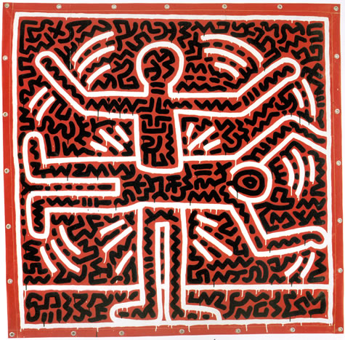
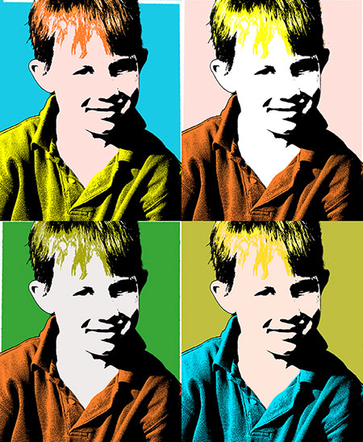
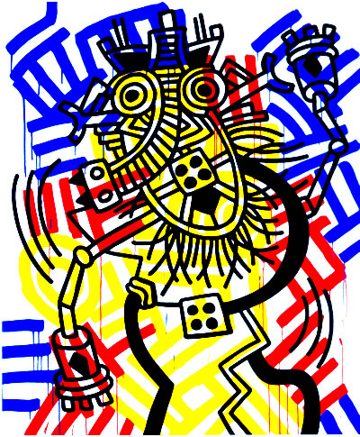
Aesthetic Theories of Art
Formalism: A theory of art which places emphasis on design qualities. According to this theory, the most important thing about the work is the effective organization of the elements of art and use of the principles of design.

Slide 6
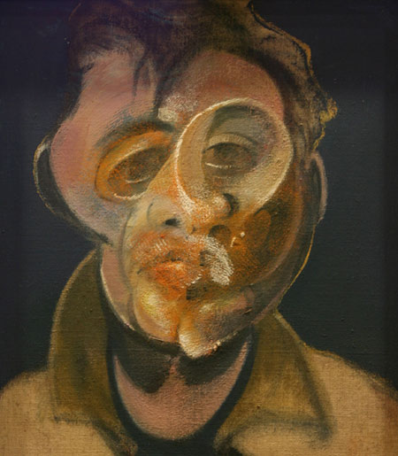
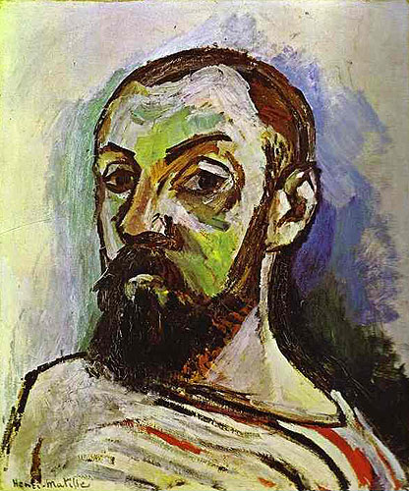
Aesthetic Theories of Art
Emotionalism: A theory of art which places emphasis on expressive qualities. According to this theory, the most important thing about a work of art is the vivid communication of moods, feelings and ideas.

Slide 7
Functionalism
The doctrine that the function of an object should determine its design and materials.
Object designed for it’s use.

Slide 8
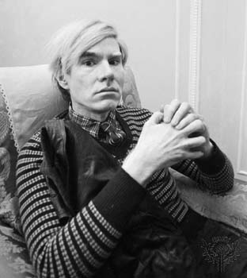
Andy Warhol
American Pop artist
1928-1987
Controversial Figure
Author, Film Maker, Artist
One of the most influential artists of the 20th Century

Slide 9
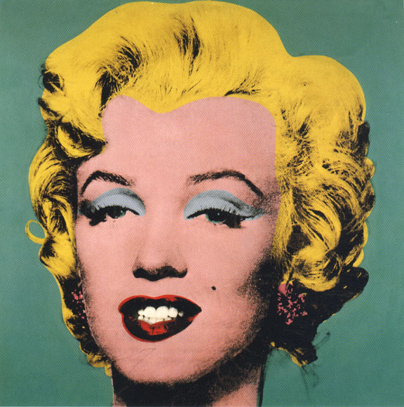
Marilyn 1967

Slide 11
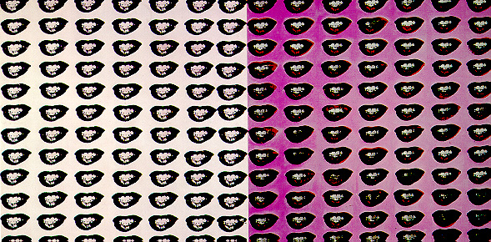
Marilyn Monroe’s Lips 1962

Slide 12
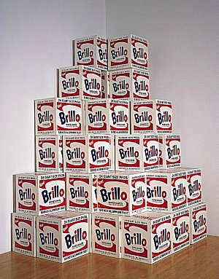
Brillo Boxes 1969

Slide 13
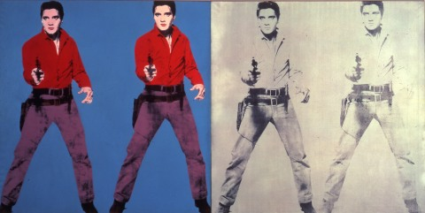
Elvis

Slide 15
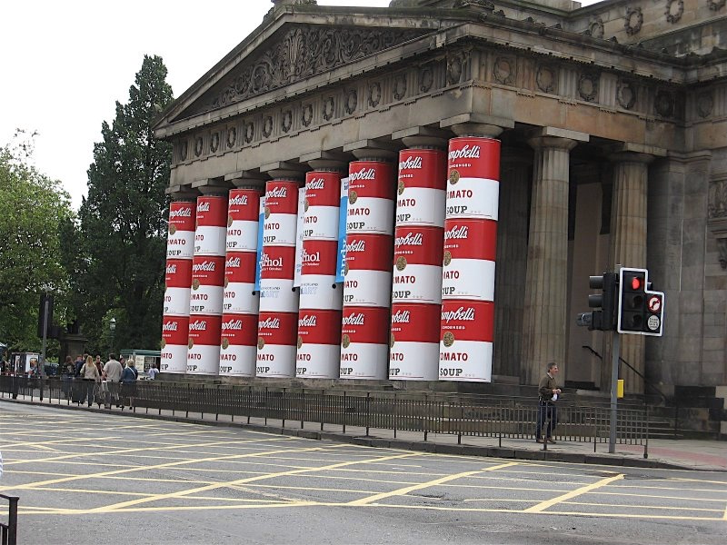
National Gallery of Scotland

Slide 16
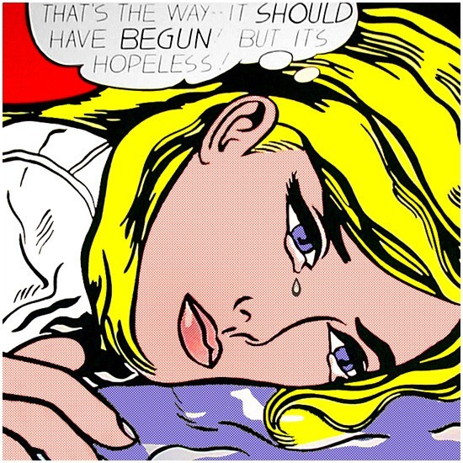
Roy Lichtenstein: Pop Art
‘Hopeless’ 1963

Slide 17
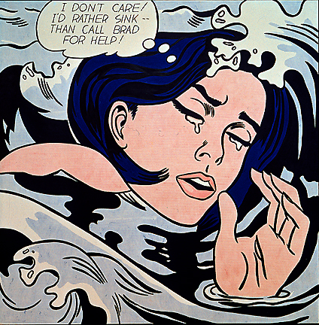
‘When will it end’

Slide 18
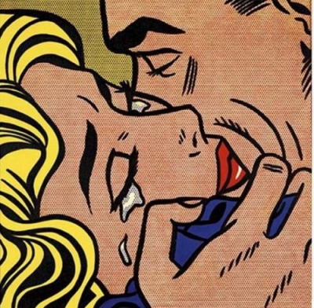
‘Kiss V’

Slide 19
Crying girl

Slide 20
‘Varoom’

Slide 21
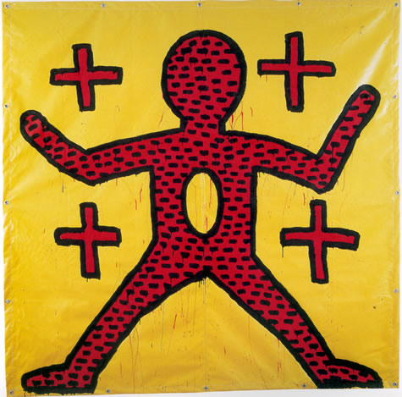
Keith Haring : Pop Art
‘Untitled’

Slide 22
‘Untitled’

Slide 23
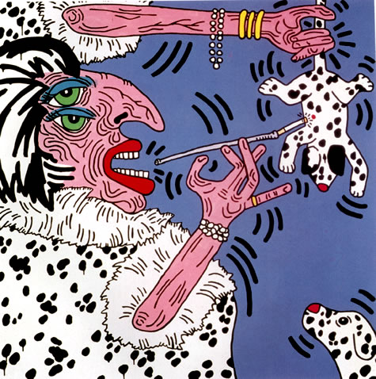
Cruella De Vile

Slide 24
‘Red Yellow Blue’

Slide 25
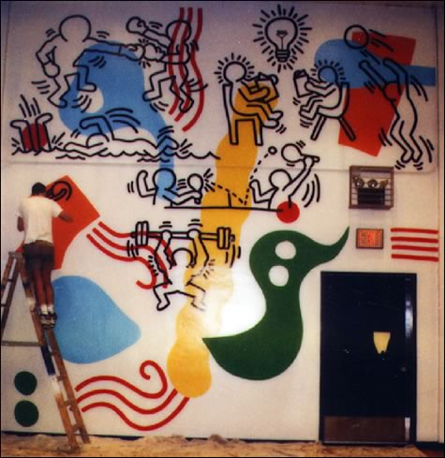
Club Mural

