Slide 1
Introduction to
P R I N T M A K I N G
Notes:
1

Slide 2
PRINTMAKING
PRINTING PLATE the surface on which the picture or design is made this is also called your MATRIX.
A plate can be anything from copper to a plastic cutting board.

Slide 3
PRINTMAKING
PRINTING PLATE the surface on which the picture or design is made this is also called your MATRIX.
A plate can be anything from copper to a plastic cutting board.

Slide 4
PRINTMAKING
PRINTING PLATE the surface on which the picture or design is made this is also called your MATRIX.
A plate can be anything from copper to a plastic cutting board.

Slide 5
PRINTMAKING Techniques
Relief
Intaglio
Lithography
Silkscreen
Collagraph
Monoprint

Slide 6
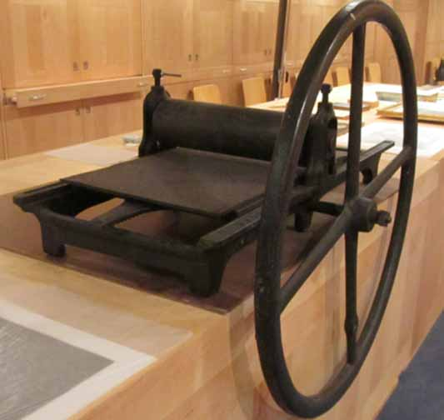
PRINTMAKING PRESS
Notes:
6

Slide 11
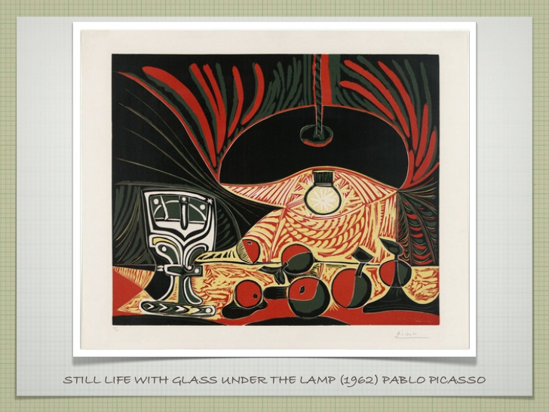

Slide 13
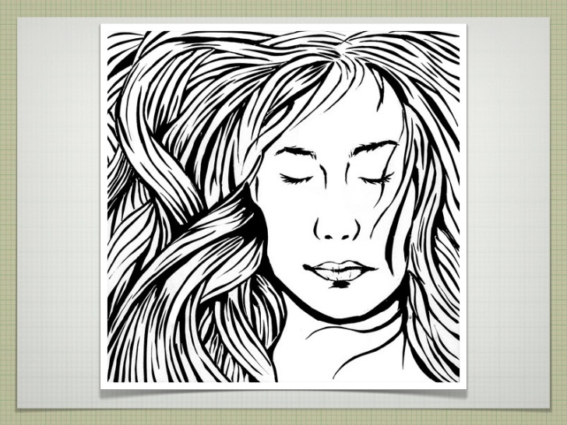

Slide 14
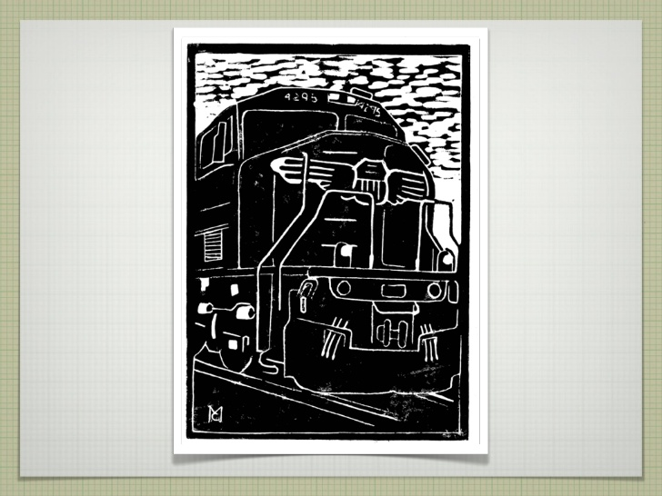

Slide 15
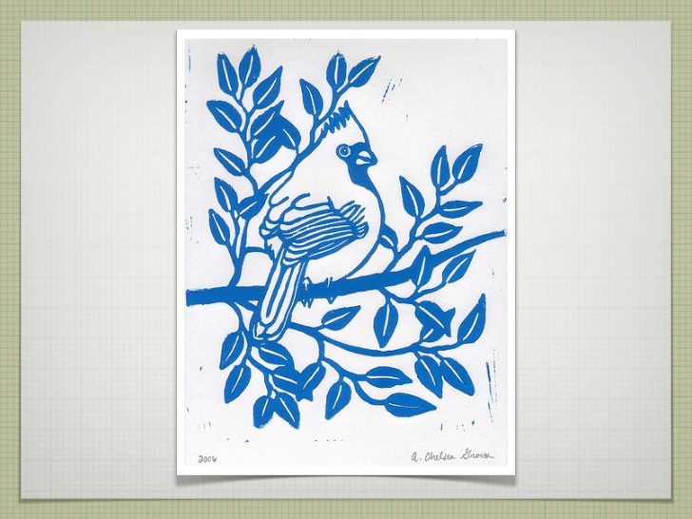

Slide 16
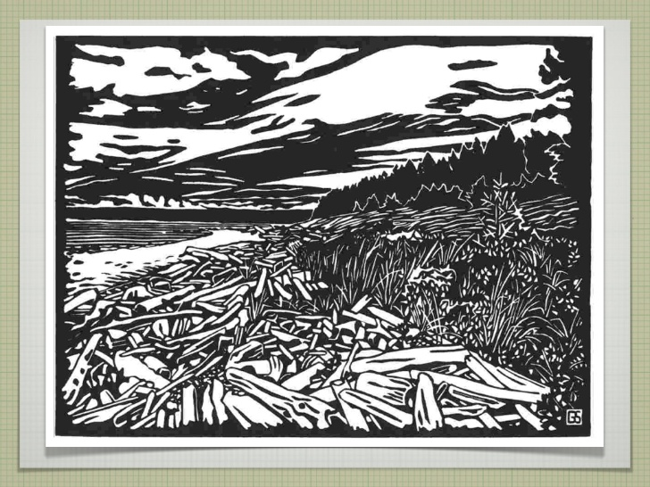

Slide 17
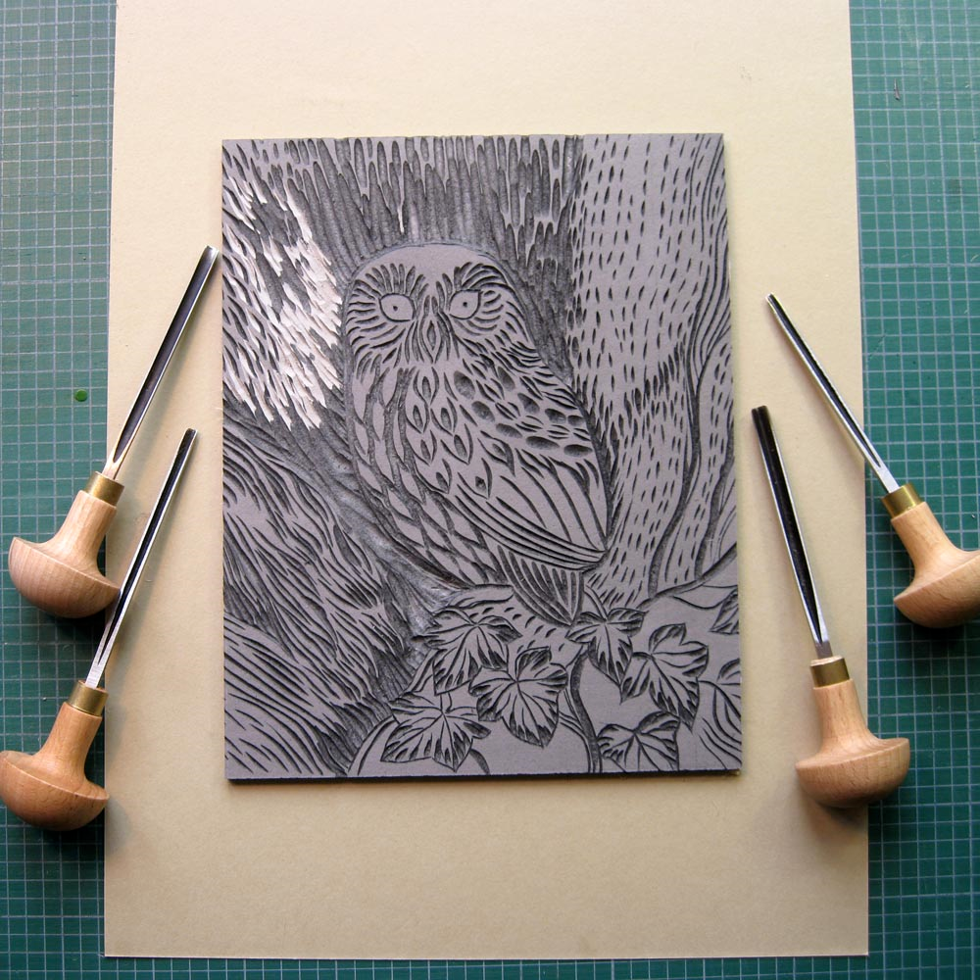
PRINTMAKING Techniques
Relief (wood or linoleum)
Made by carving into the surface of a plate. Ink clings to the un-carved surface of the plate.

Slide 18
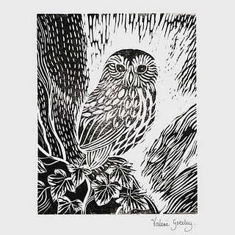
PRINTMAKING Techniques
Linoleum Relief Print

Slide 19
PRINTMAKING Techniques
Relief
PLATE PRINT
WHAT DO YOU NOTICE?

Slide 20
PRINTMAKING Techniques
Relief
PLATE PRINT
Prints print in reverse!

Slide 21
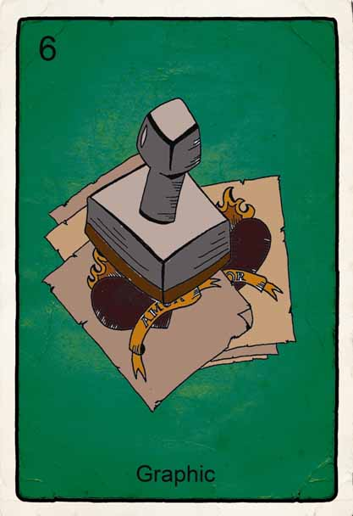
Why do you suppose some artists choose printmaking, rather than drawing or painting, when they want to communicate their feelings or ideas to lots of people?
Notes:
21

Slide 22
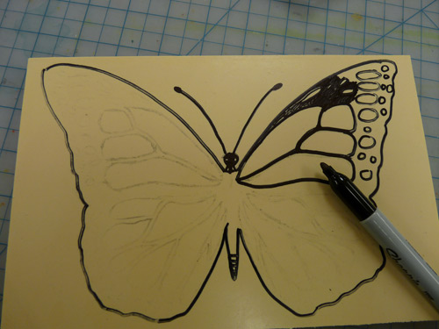
Your TASK is to create a drawing of an endangered species
Your drawing needs to incorporate TEXTURE through patterns
You will transfer this picture onto your piece of linoleum

Slide 23
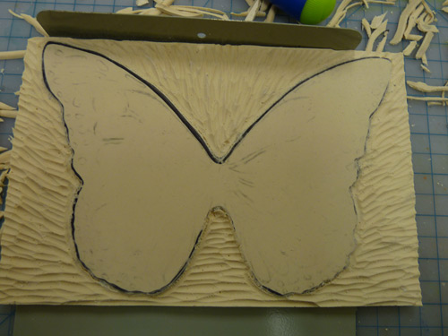
Carve the background texture first, leaving your animal blank

Slide 24
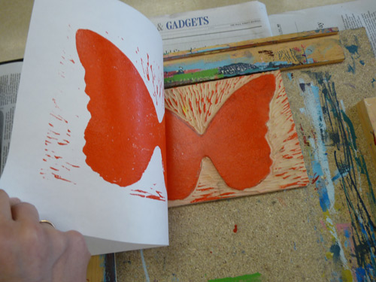
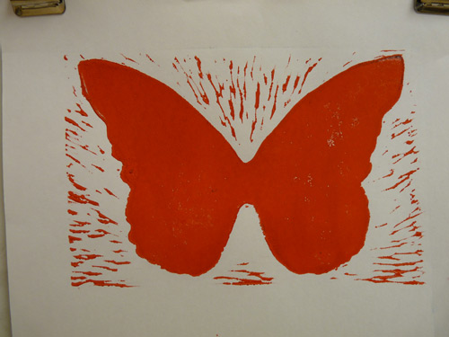
Pick the color you would like for your animal- Print 13 “perfect” copies. You may use different colors.

Slide 25
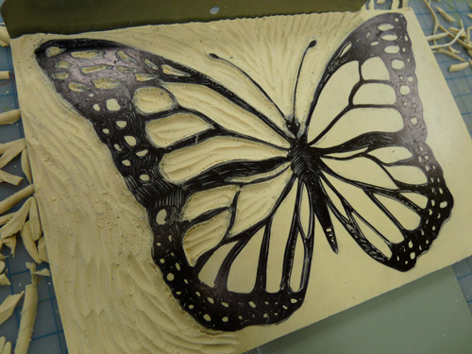
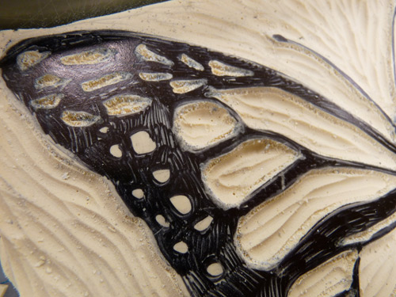
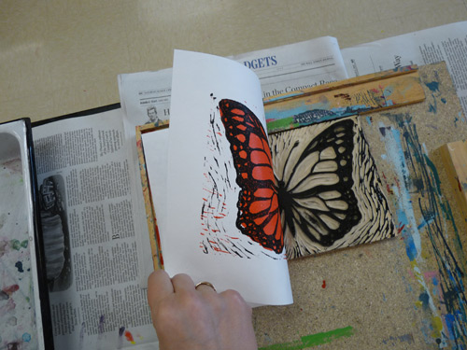
Carve the lines out of your animal, reprint with another color on your colored pages…

Slide 26
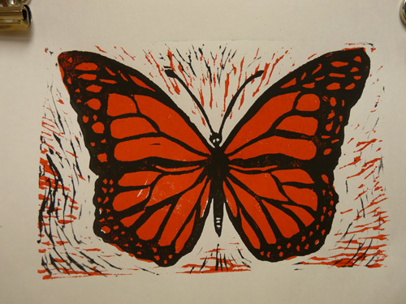
Tada! Date in the left corner, Title in the middle, and Name in the right corner, and You’ve made your print!
You will give one to each classmate to make a book, along with 3 paragraphs on your endangered species.

