Slide 1
Sequential Art

Slide 2
What is Sequential Art?
Sequential art is images used in sequence of each other for graphic storytelling or to convey information.
A very popular form of this type of art is Comic Books.

Slide 3
Sequential Art in History
Sequential Art is embedded in many cultures and throughout history. Some of the first people to use Sequential Art were the Egyptians with their Hieroglyphs, as well as the Greeks and Mayan cultures.
In fact, Sequential art is one of the most basic ways for different language speakers to communicate with each other.

Slide 4
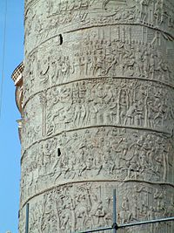
Trajan’s Column
Trajan's Column (Italian: Colonna Traiana) is a Roman triumphal column in Rome, Italy, that commemorates Roman emperor Trajan's victory in the Dacian Wars.
It is a continual story that starts up around the tower from base to capital, with the narrative band expanding from about 3 feet at the base of the column to 4 feet at the top, allowing for easier viewing of the frieze. The relief portrays Trajan's two victorious military campaigns against the Dacians; the lower half illustrating the first, and the top half illustrating the second.
The two sections are separated by a personification of Victory writing on a shield flanked on either side by Trophies. Otherwise, the scenes on the frieze unfold continuously and in tipped-up perspective. It was built in 113 AD.

Slide 5
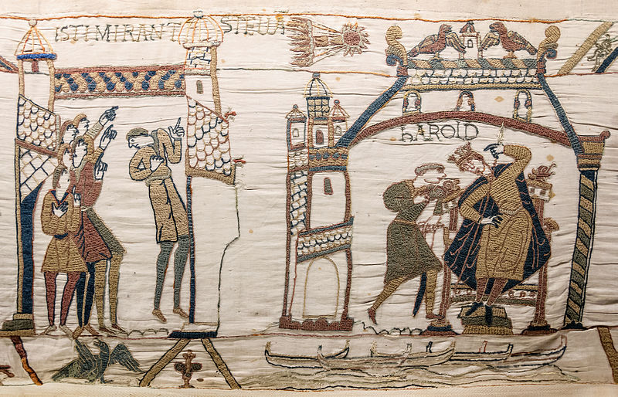
Bayeux
The Bayeux Tapestry is an embroidered cloth—not an actual tapestry—nearly 230 ft long, which depicts the events leading up to the Norman conquest of England concerning William, Duke of Normandy, and Harold, Earl of Wessex, later King of England, and culminating in the Battle of Hastings. It was constructed in the 1070’s.
Halley's Comet (legend above: Isti Mirant Stella, "These (men) wonder at a star") and Harold at Westminster.

Slide 6
Present Day Sequential Art- Comics
Comics is a visual medium used to express ideas via images, often combined with text or visual information. Comics frequently takes the form of juxtaposed sequences of panels of images. Often textual devices such as speech balloons, captions, and sound effects ("onomatopoeia") indicate dialogue, narration, or other information..
The history of comics has followed divided paths in different cultures. Scholars have positioned it as far back as the Lascaux cave paintings. By the mid-20th century, comics flourished particularly in the US, western Europe (particularly France and Belgium), and Japan.
American comics emerged as a mass medium in the early 20th century with the advent of newspaper comic strips; magazine-style comic books followed in the 1930s. Japanese comics and cartooning ("manga") traces its history to the 13th century. Modern comic strips emerged in Japan in the early 20th-century in imitation of Western strips, and by the 1930s comics magazines and book collections became common. The post-World War II era saw the popularity of cartoonists such as Osamu Tezuka lead to rapid expansion of the popularity of comics in Japan.

Slide 7
Graphic Novels
Graphic novels have emerged as an extension of comic strips taking after the Japanese Manga style of comics. They are full length novels filled with pictures as well as words for people to read. You can find some in your library at school.

Slide 8
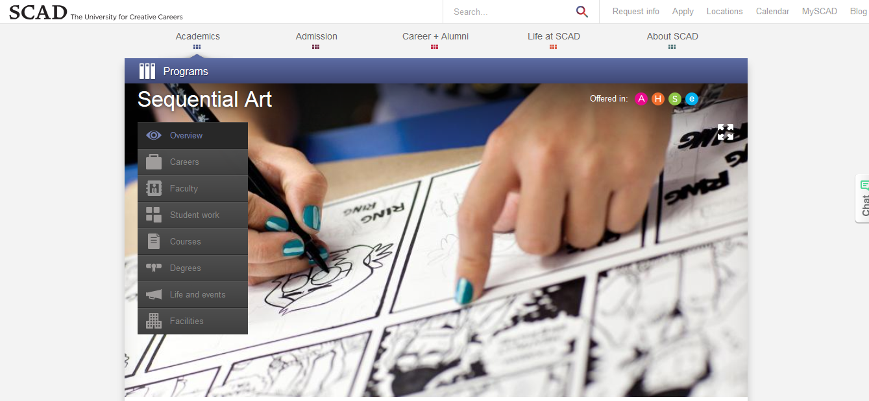
SCAD
Savannah College of Art and Design is one of the only colleges in the United States that you can study Sequential Art and learn how to be a comic book artist as a degree.

