Slide 1
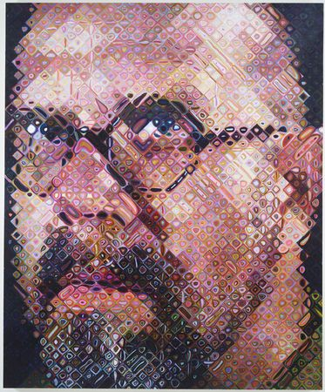
Chuck Close

Slide 2
Charles Thomas "Chuck" Close (born July 5, 1940) is an American painter and photographer who achieved fame as a photorealist, through his massive-scale portraits. Though a catastrophic spinal artery collapse in 1988 left him severely paralyzed, he has continued to paint and produce work that remains sought after by museums and collectors. Close currently lives and works on the south shore of Long Island, New York.
Before his accident his main work was photorealism or hyperrealism portraits of friends. After his accident he started painting with a paintbrush strapped to his hand because he was unable to hold it on his own. His work became much more abstract.

Slide 3
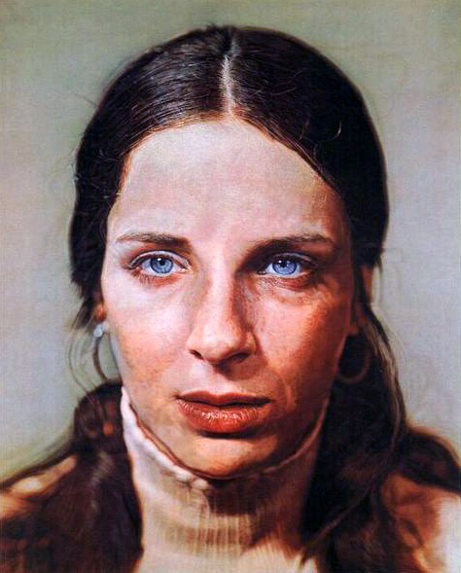
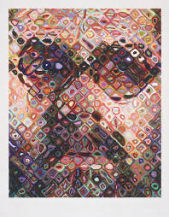
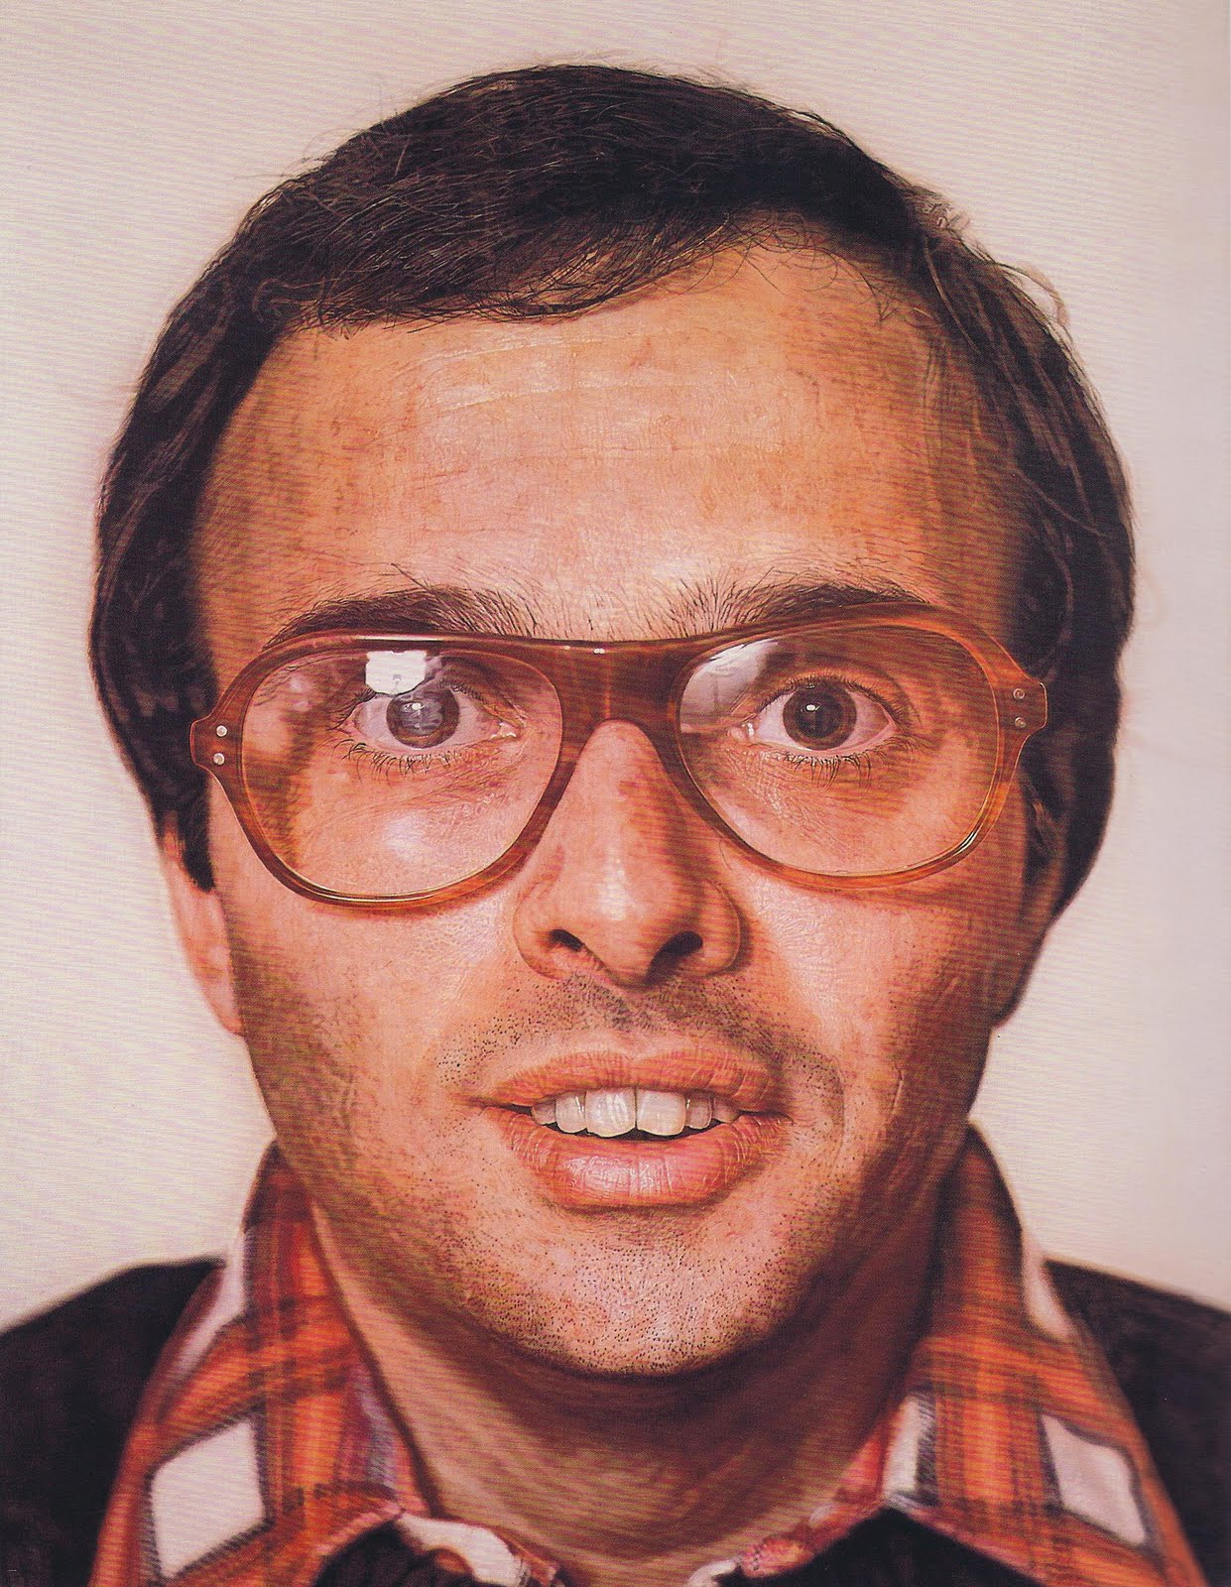
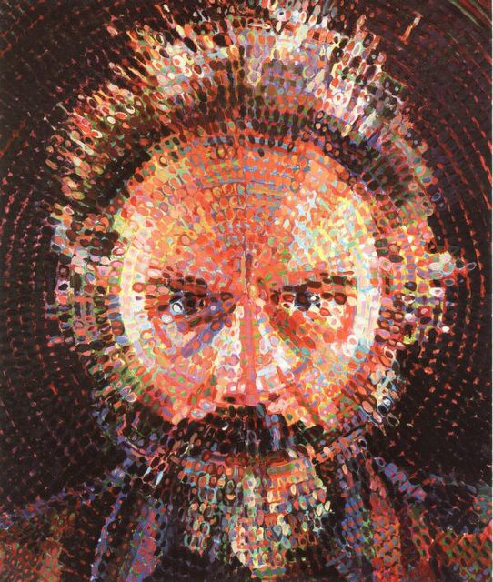
Photorealism before accident:
After Accident:

Slide 5
Why Chuck Close follows a grid

Slide 6
Thoughts?
Which type of art do you prefer?
Your Turn-
Find a picture from either a magazine or a photograph that is at least 6x9 to draw. We can blow it up on a copy machine if needed.
You will recreate this picture on a 12x18 paper with pencil and color it with either watercolor or tempera paint.

